Slide 1

Bangladesh University of Engineering and Technology
Department of Electrical and Electronic Engineering
Project Presentation eee 304_B1
Date: 03/12/2024
FPGA-Powered Real-Time Quizzing System
Prepared by:
Sheikh Tariful Islam(2006066)
Md Al Saif Hossain Anay(2006077)
Md Nakib(2006091)
Md. Mostafizur Rahman(2006096)
Submitted to:
Nafis Sadik
Lecturer
Department of EEE,BUET
H M Tahmeed-Ul-Islam
Lecturer(PT)
Department of EEE,BUET

Slide 2
Introduction
Objective
Workflow
Methodology
Hardware Implementation
Work Progress
Individual Contribution
Demonstration
Different Segment of Main Code
Overview

Slide 3
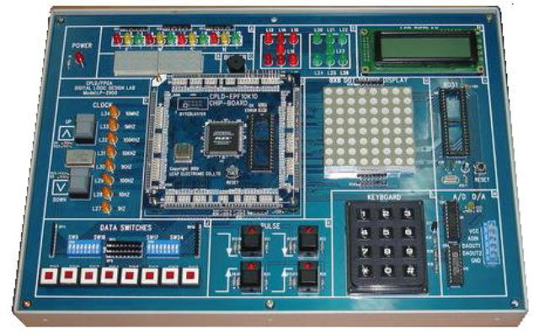

Introduction
FPGA (Field Programmable Gate Array) board is a great way to implement high performing automated system like quizzing system.
FPGA board is a good choice where real time processing, low latency and scalability is required

Slide 4
Objective
Design a user friendly quizzing system
Implement complete quizzing system – including question selection, answer processing, score calculation and winner declaration
Showcase FPGA capabilities – demonstrating flexibility and performance advantages of FPGA

Slide 5

Work Flow
Initial Score
Team B will get 1 point
So the total point will be 7
5
Team A
Adds point to Score
Team B
Yes
Store the score
6
Team B
Ans within 10sec
Team Selection
Team C
Doesn't add any point to score
This new score will be stored for further comparison
3
NO
Yes
Team D
4
Lets Assume Team B has pressed the Buzzer First
Judge
Yes/No
Given Answer by Team B is correct hence Judge presses yes

Slide 6
Work Flow
Final Score
Score of Team A
5
7
Score of Team B
Comparator will pass Team B
Comparator
Winner Declaration
Team B will be declared winner
Score of Team C
3
Score of Team
Push the Button
The whole game will be reset
4
Master Reset

Slide 7
Methodology
Team Selection
Time Counter
Answer Evaluation
Score Update
Winner Declaration
System Reset

Slide 8


Methodology
Whoever Presses the buzzer first will get the chance to answer
Team Selection
TeamA
TeamB
TeamC
TeamD
TeamB

Slide 9
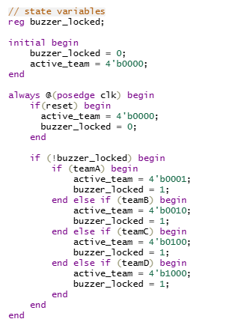
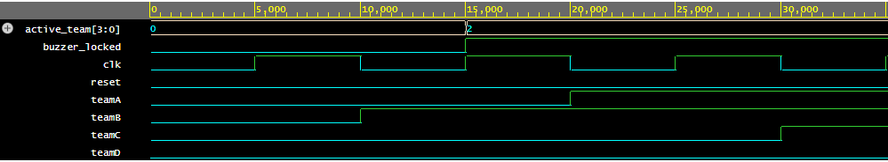
Team Selection
Verilog Code:
Vector Wave Form:

Slide 10

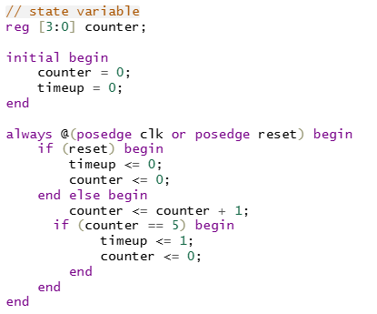



Time Counter
Once a Team is selected the timer will start counting time
In our quizzing system we will give 10 sec to answer a question
If the question is not answered within the time no points will be added
Verilog code for timer

Slide 11
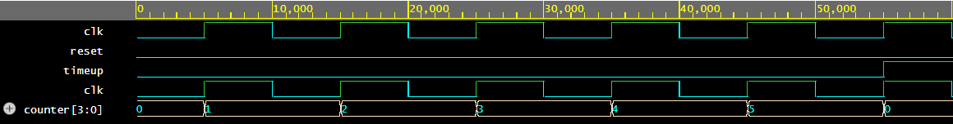
Time Counter
Vector Wave Form

Slide 12

Answer Evaluation
If the answer is right, judge will press yes button
If the answer is wrong then judge will not press any button

Slide 13

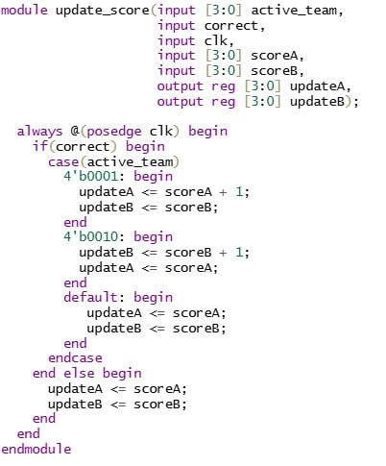
Score Update
Verilog code
If judge press yes button then score of the team that has pressed the buzzer first will increase
Other wise the score will be the same as previous

Slide 14
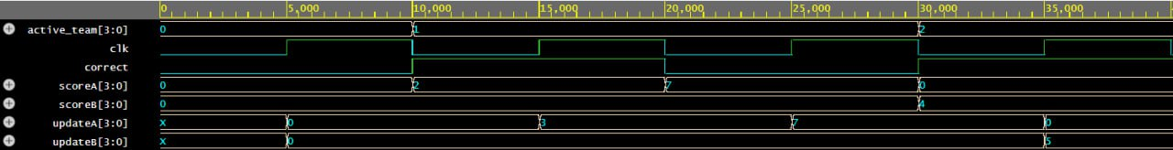
Score Update
Vector Wave Form

Slide 15

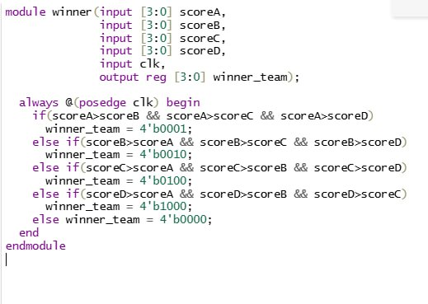
Winner Declaration
The team that has scored highest will be the winner
Winner team's score will be displayed in FPGA using the 7 segment display
Team num of the winning team will be showed using a ouput LED
Verilog Code:

Slide 16
Winner Declaration
Vector Wave Form

Slide 17

System Reset
Reset:
After every question answer the buzzer needs to be prepared for next question
Using Reset button we complete this work
Master Reset:
Once a match is completed whole system needs to be reset
Master Reset serves this purpose

Slide 18

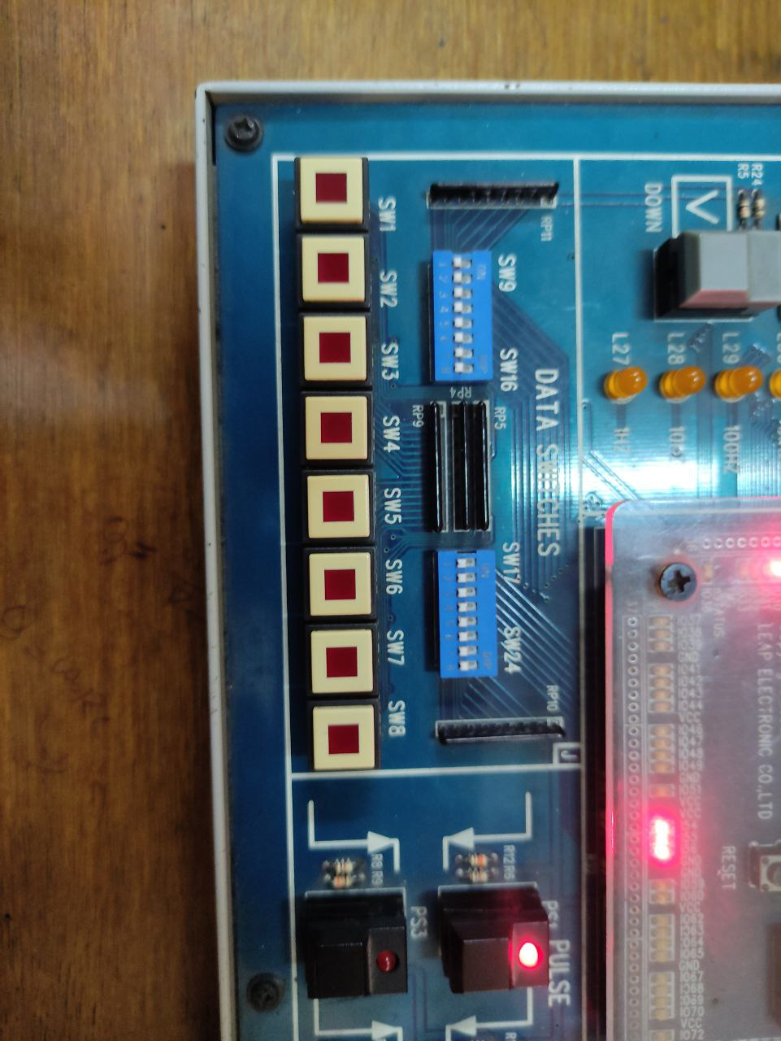
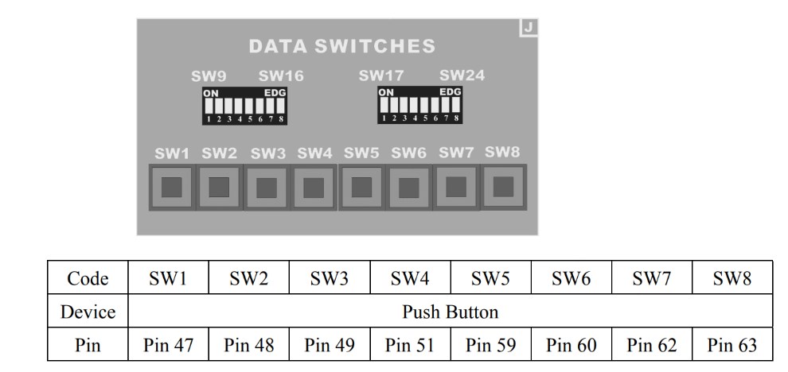
Hardware Implementation
Description of Input Switches:
Team A
Team B
Team C
Team D
Winner
Declaration
Correct
Reset
Master Reset

Slide 19
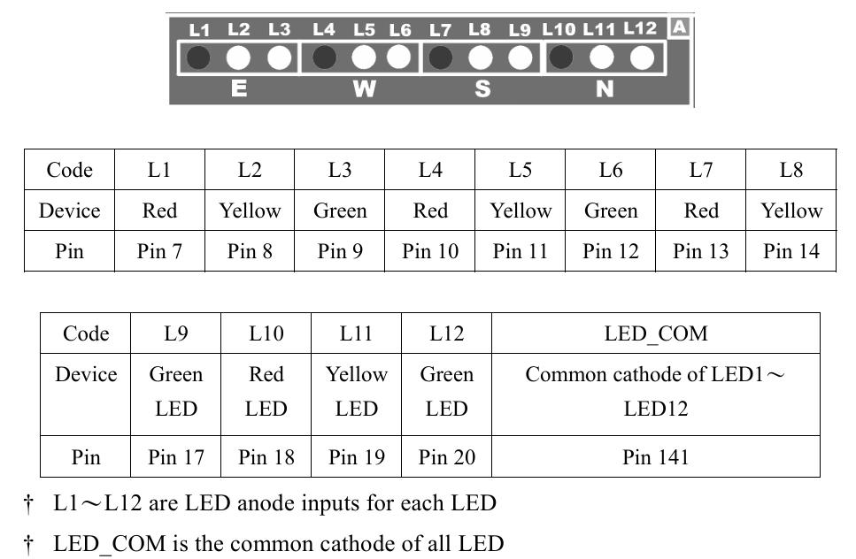
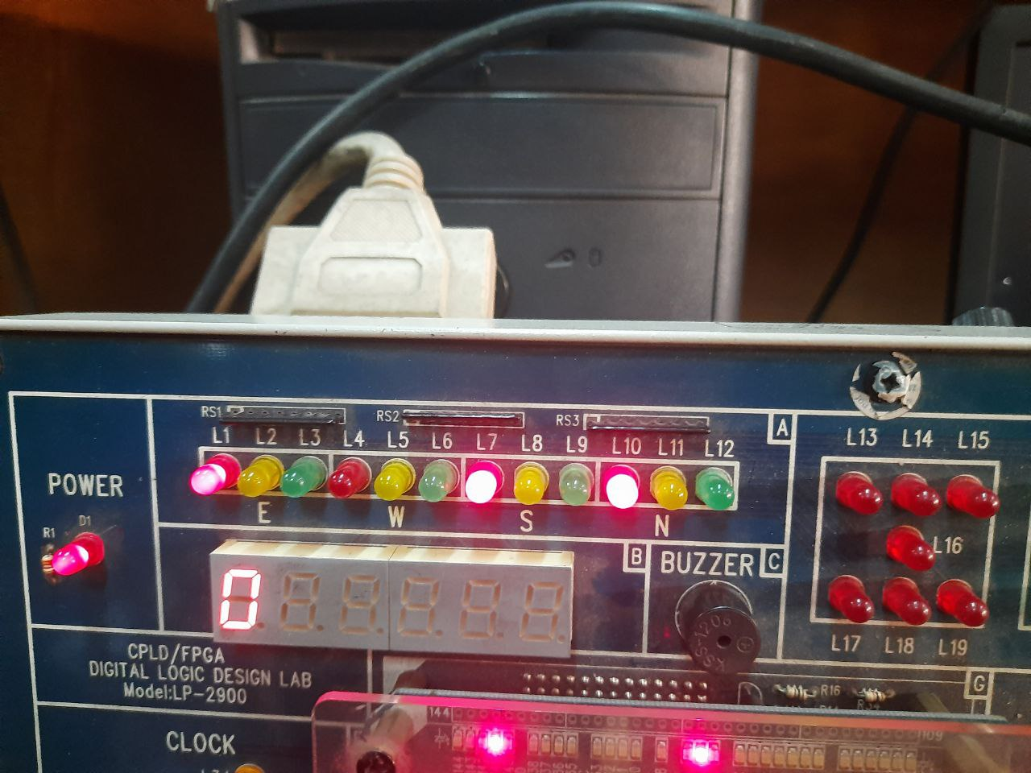
Hardware Implementation
Description of Output LEDs:
Team A
Team B
Team C
Team D
Time Up
(10 sec)
Buzzer Locked

Slide 20
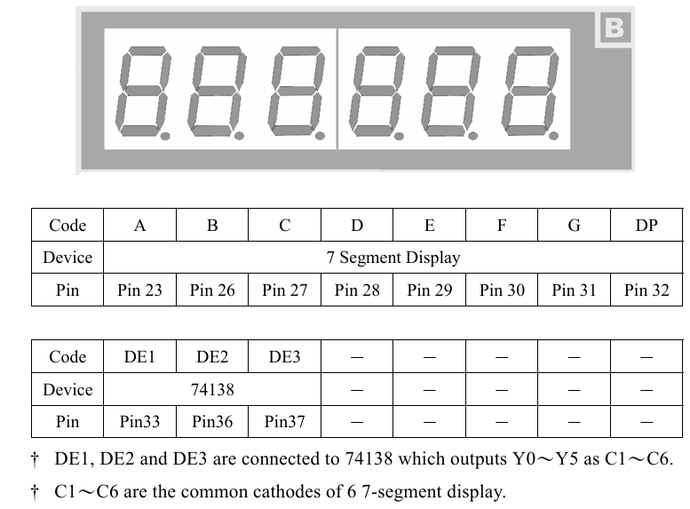
Hardware Implementation
Description of 7 Segment display(Used as an output):
7segment display is used for showing the time counting
It will also show the number of the participant who answered the question

Slide 21
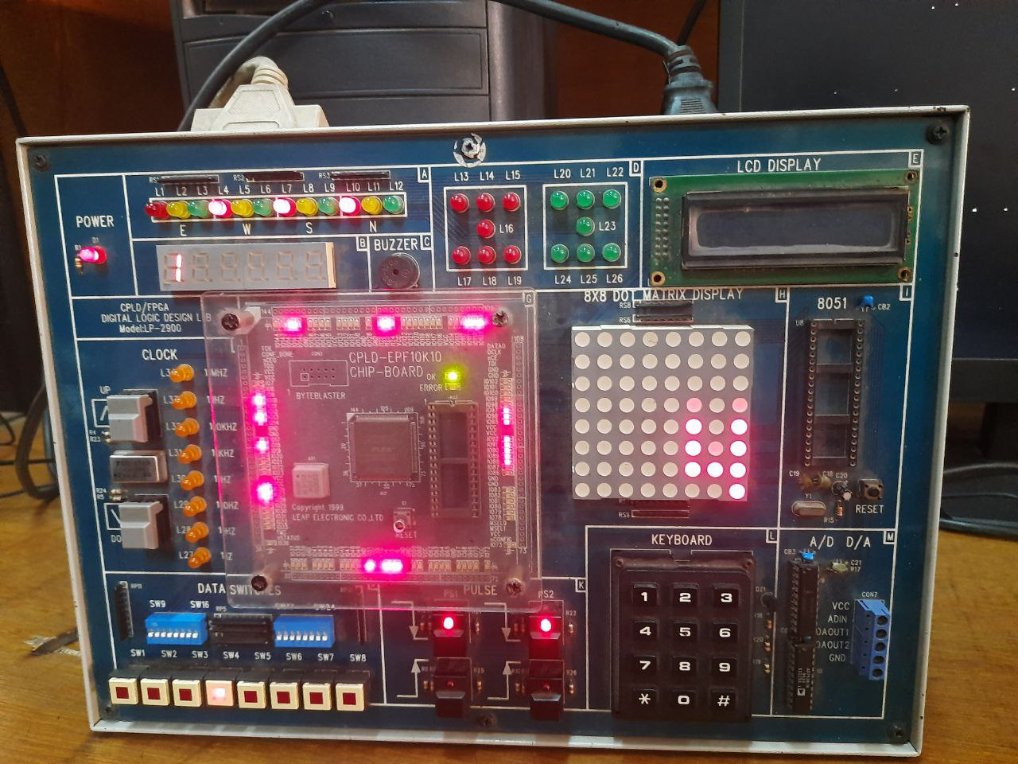
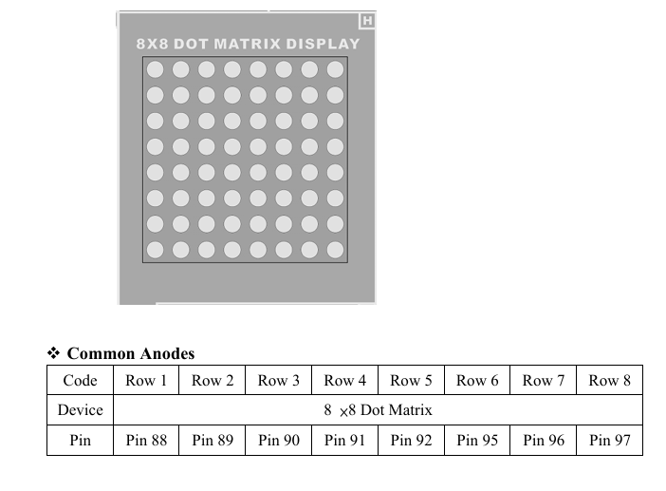
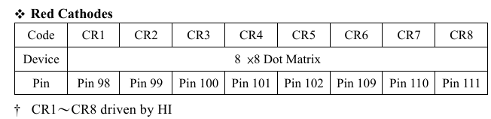
Hardware Implementation
Description of DOT Matrix Display(used as an output):
In the DOT Matrix the selected team(who presses the buzzer first) is displayed

Slide 22
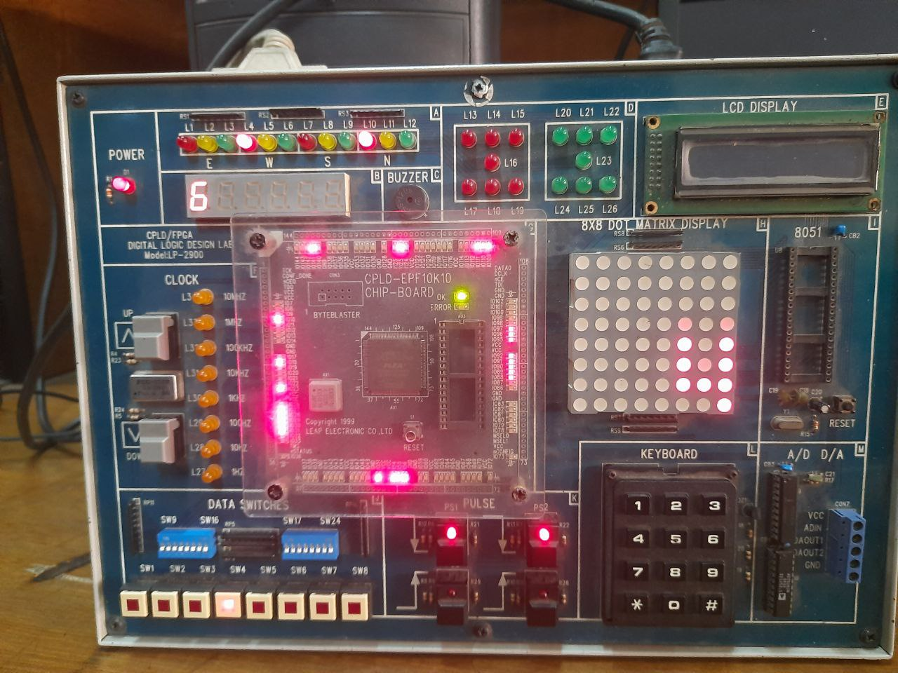
Hardware Implementation
Team Selection:
Count down has started
Team 4 presses the buzzer first
The buzzer is locked

Slide 23
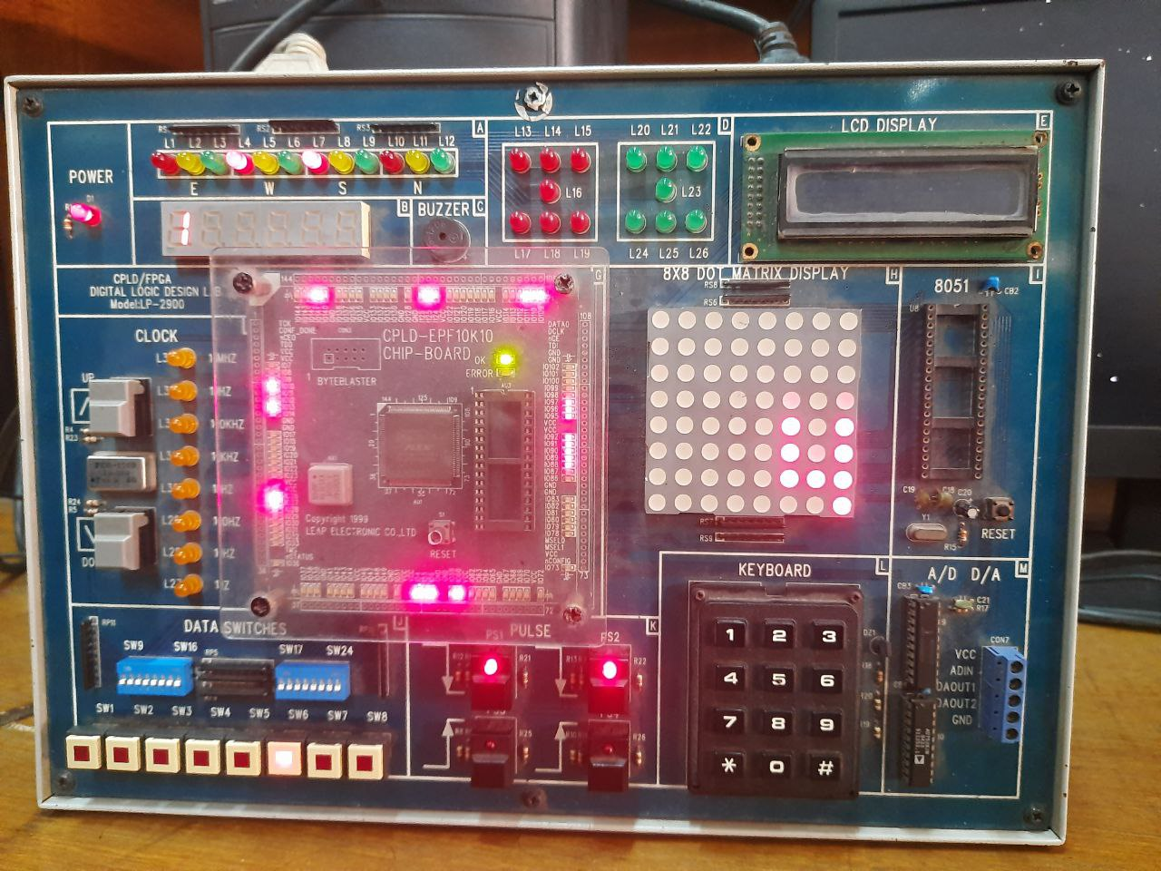

Hardware Implementation
Evaluation:
Time is up
Time up indicating light is on
Given Answer is correct
Total point of Team 4 is increased

Slide 24
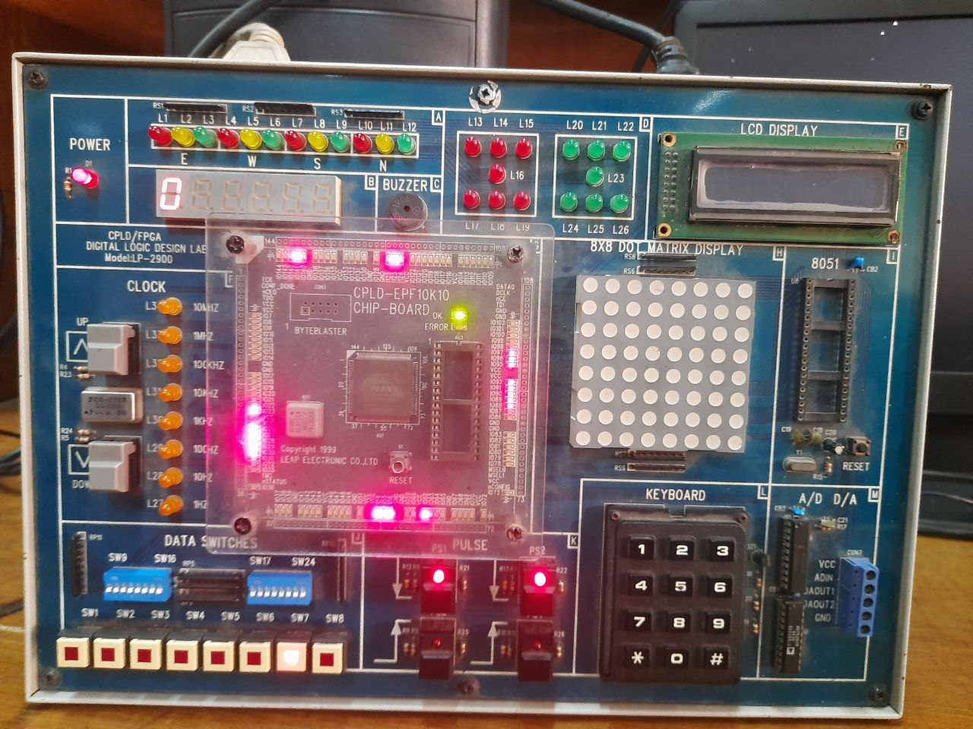
Hardware Implementation
Reset for next question:
Reset button is pressed for next question
No team is activated hence the output lights for 4 teams are off
Time counter is again ready to count time for this newround

Slide 25
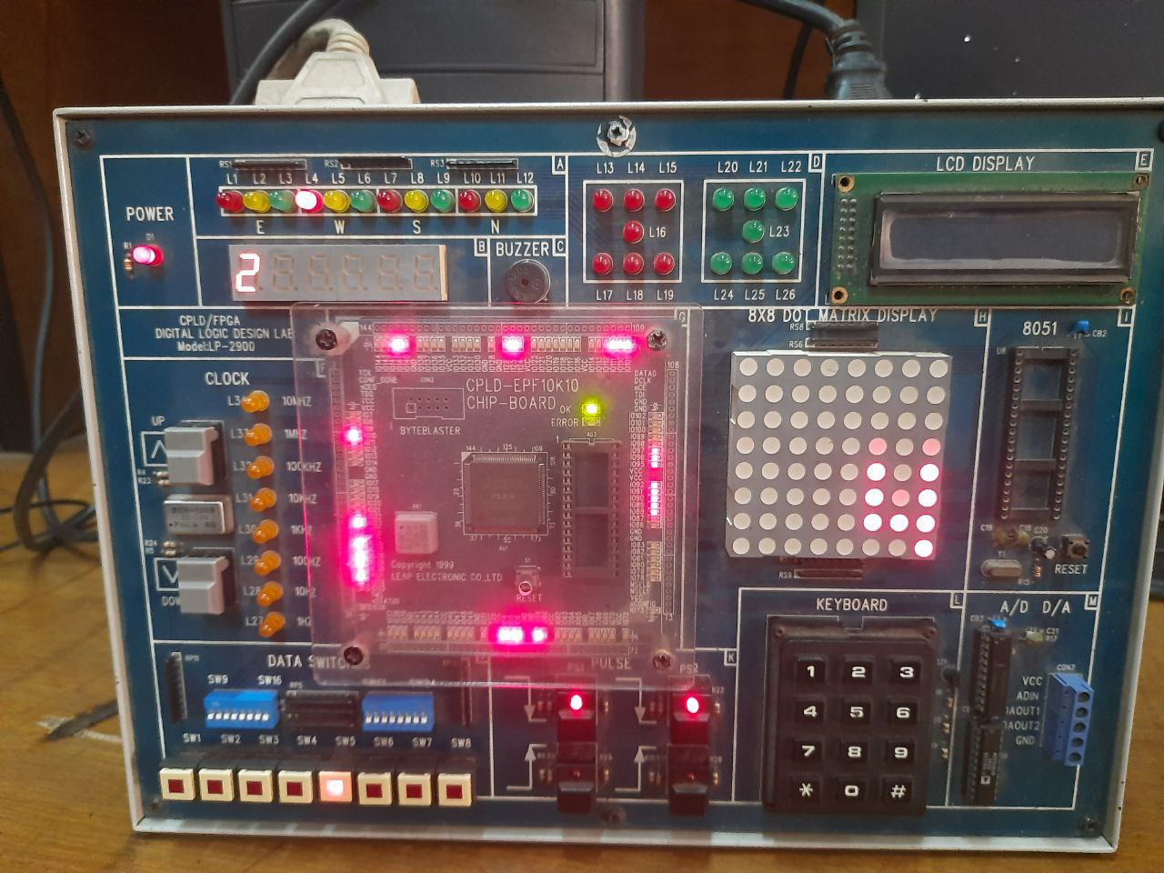

Hardware Implementation
Winner Declaration:
For ending the game winner declaration button is pressed
In this situation scores for 4 respective is T1(1),T2(0),T3(0),T4(2)
So the winner is Team 4
Team number is shown in DOT MATRIX display
Winner's score is shown in 7 segment display

Slide 26
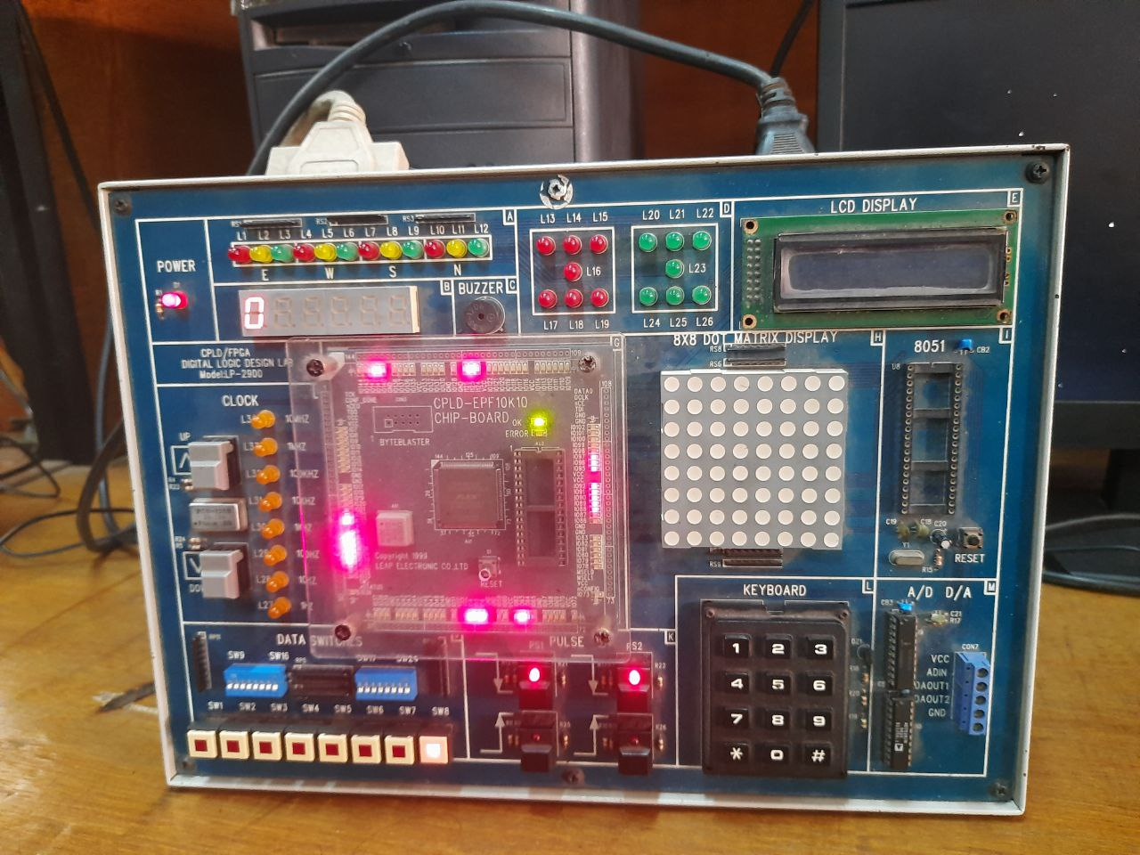
Hardware Implementation
Preparing the system for a new game:
For restarting a new game we need to press the Master Reset Button
This will clear all the previous data that was recorded

Slide 27

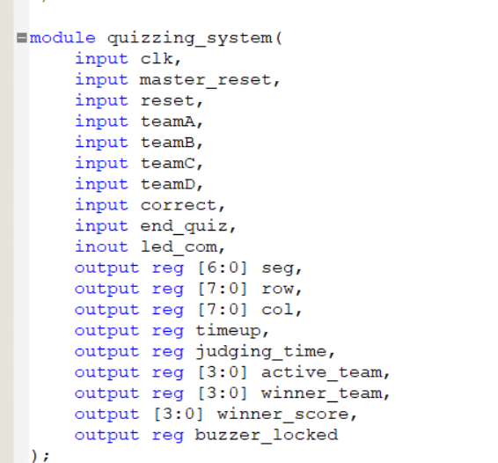
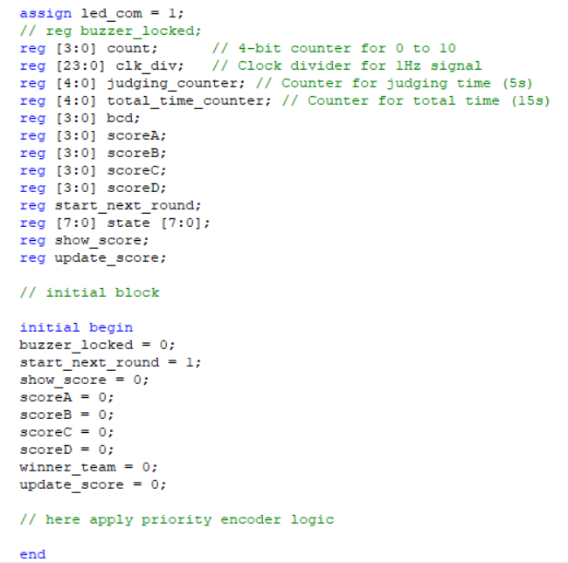
Different Segment of Main Code
Variable declaration and initialization:

Slide 28
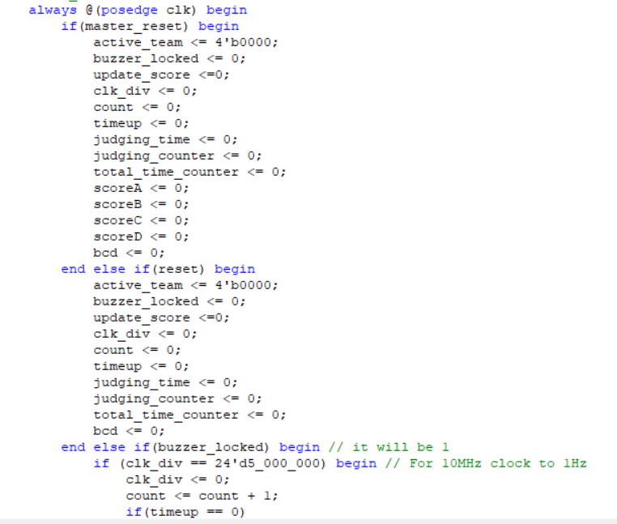
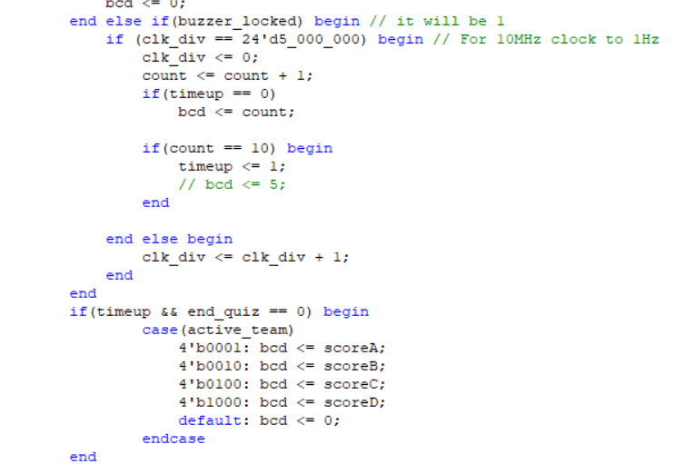
Different Segment of Main Code
Buzzer lock ,Score update, Score store:

Slide 29
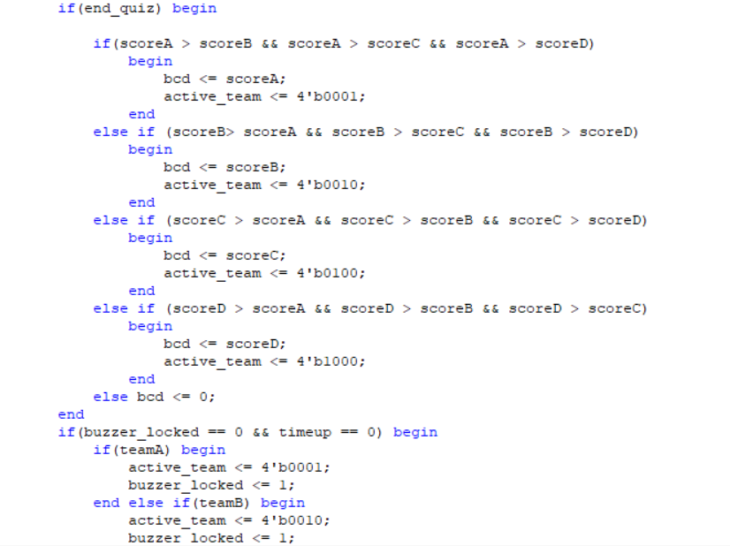
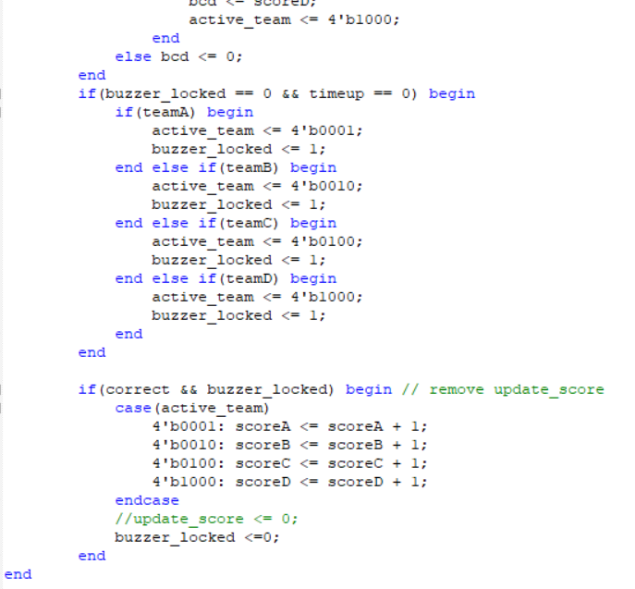
Different Segment of Main Code
Buzzer lock ,Score update, Score store:

Slide 30
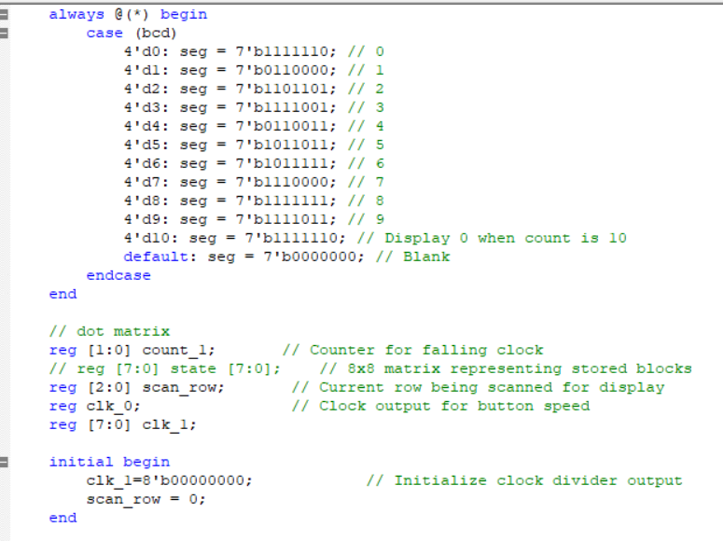
Different Segment of Main Code
7 Segment Display:

Slide 31
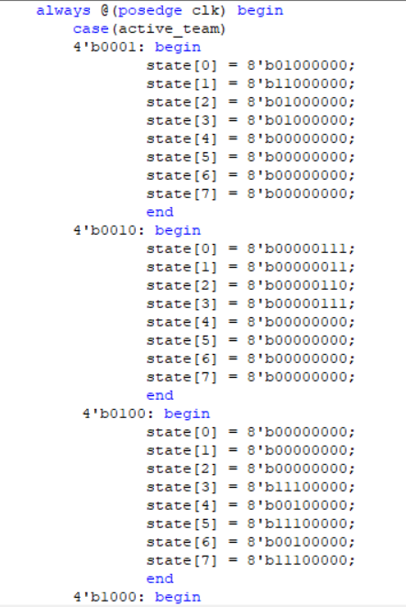
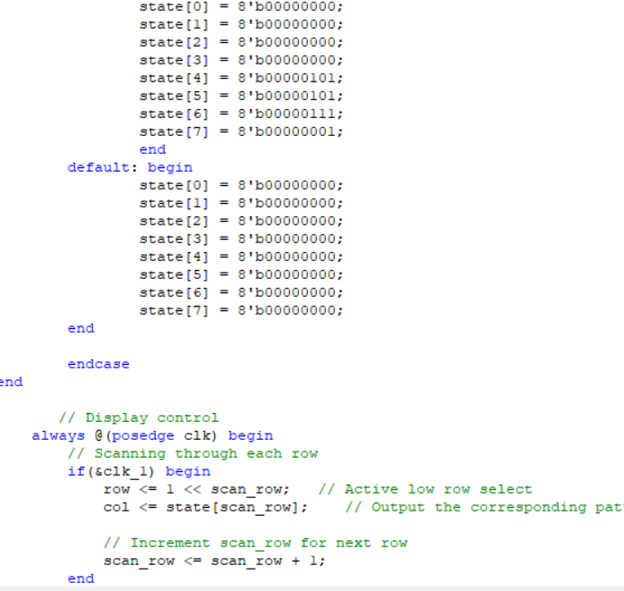
Different Segment of Main Code
DOT MATRIX Display:

Slide 32
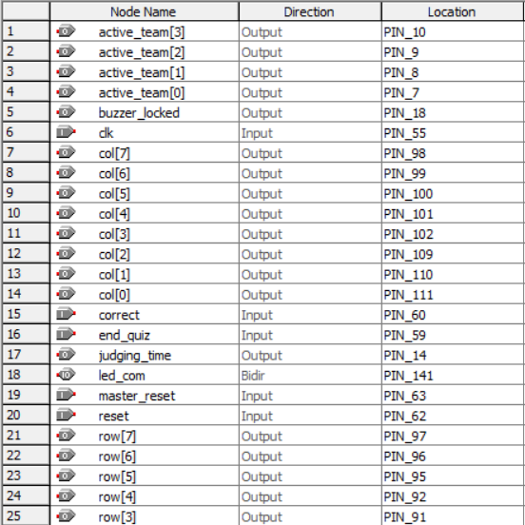
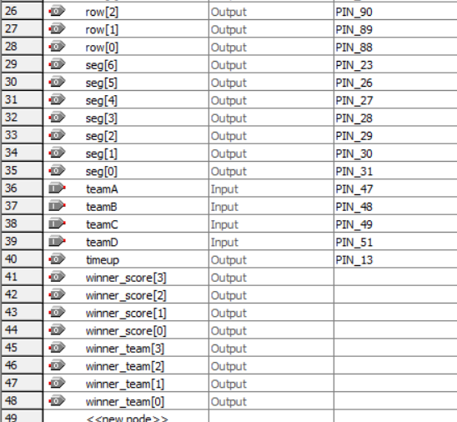
Different Segment of Main Code
Pin Planner:

Slide 33


Work Progress
Understanding the Problem
Coding for different part of the problem
Combine all the coding in single file and compile
Update the code for uploading in a CPLD board
Full implementation in CPLD board
Observe the Vector Wave Form

Slide 34

Individual Contribution
Name of the Task | Student ID
Designing the whole system | 2006066,2006077,2006091,2006096
Coding for priority encoder | 2006091
Coding for Counter | 2006091
Coding Score update and winner declaration | 2006096
Coding for 7 Segment Display | 2006066
Coding for DOT MATRIX Display | 2006077
Compiling Full code | 2006091,2006077
Debugging | 2006066,2006096
Upload in CPLD | 2006066,2006077,2006091,2006096

Slide 35

Demonstration

Slide 36
Thank you

